Slide 1
CSSE332 Operating System
Mutexes and Condition Variables
The slides are partially adapted from Dr. Peter Bui@ND

Slide 2
Outline
Key Concepts of Concurrency Issues
A primer on Mutex
Intro to Condition Variables

Slide 3
Concurrency Terms
The critical section is a code segment where the shared variables can be accessed. An atomic action is required in a critical section i.e. only one process can execute in its critical section at a time.
Mutual exclusion describes the property enabled by a critical section that if one thread is executing within the critical section, the others will be prevented from doing so.
A race condition (or data race) arises if multiple threads of execution enter the critical section at roughly the same time

Slide 4

Mutex: Binary lock
A mutex is a binary lock (or a binary semaphore)
You either have the lock, or you must wait for it
Ensures mutual exclusion
pthread_mutex_t lock;
pthread_mutex_init(&lock, NULL);
pthread_mutex_lock(&lock);
pthread_mutex_unlock(&lock);

Slide 5
How to implement a mutex
We need support from hardware!
Hardware provides TestAndSet instruction
Maintain a queue of waiting threads to wake up in FIFO order
More reading about lock/mutex implementation:
https://pages.cs.wisc.edu/~remzi/OSTEP/threads-locks.pdf

Slide 6
Activity
Use mutex to resolve the race condition in thread_count.c

Slide 7
Intro to Condition Variables
Motivation:
There are many cases where a thread wishes to check whether a condition is true before continuing its execution.
For example, a parent thread might wish to check whether a child thread has completed before continuing (this is often called a join()); how should such a wait be implemented?

Slide 8
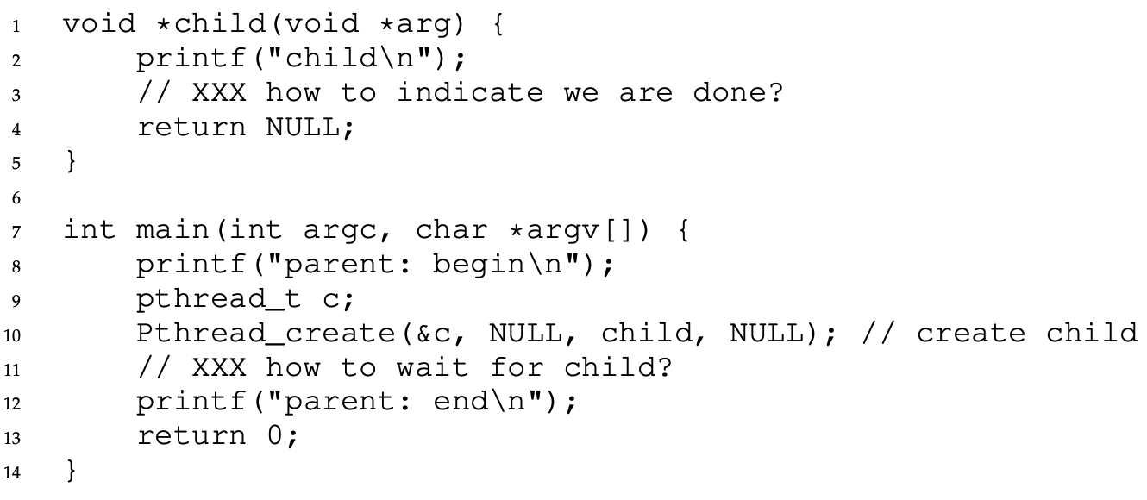
CV Motivation Example

Slide 9
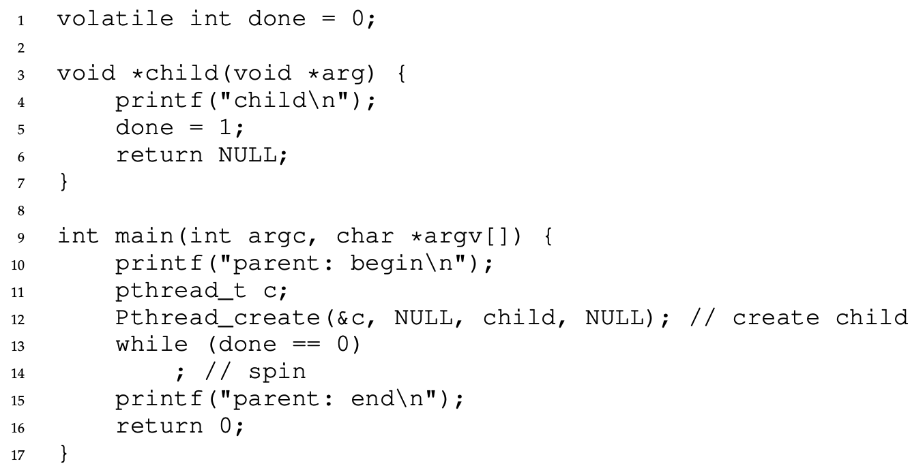
A non-CV solution

Slide 10
Condition Variable: Overview
A condition variable is an explicit queue that threads can put themselves on when some state of execution is not as desired
Rather than spin-waiting on a condition, a thread can put itself to sleep by waiting
When another thread updates the condition, it can signal another thread to wake-up

Slide 11
Condition Variable: Overview
A condition variable is an explicit queue that threads can put themselves on when some state of execution is not as desired
Rather than spin-waiting on a condition, a thread can put itself to sleep by waiting
When another thread updates the condition, it can signal another thread to wake-up

Slide 12
Condition variables API
pthread_cond_t c; pthread_cond_init(&c, 0);
pthread_cond_signal(pthread_cond_t *c)
pthread_cond_wait(pthread_cond_t *c, pthread_mutex_t *m);
Notes:
There’s also pthread_cond_broadcast
undefined behavior results if you call without a locked mutex

Slide 13
Condition Variables API (continue)
One thing you might notice about the wait() call is that it also takes a mutex as a parameter; it assumes that this mutex is locked when wait() is called. The responsibility of wait() is to release the lock and put the calling thread to sleep (atomically); when the thread wakes up (after some other thread has signaled it), it must re-acquire the lock before returning to the caller.

Slide 14
Back to the parent-child problem

Slide 15
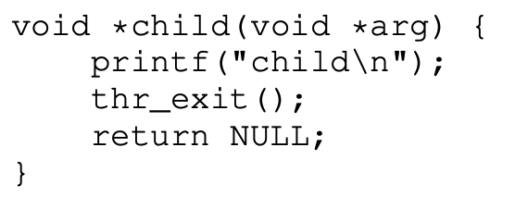
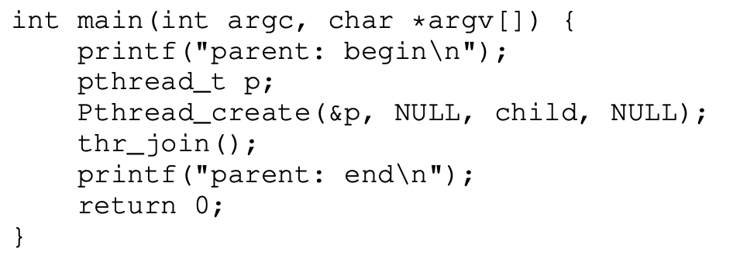

Implement two functions

Slide 16
Solution 1: No Lock
void thread_join(void)
{
if (done == 0)
pthread_cond_wait(&c);
}
void thread_exit(void)
{
done = 1;
pthread_cond_signal(&c);
}
Borken!!!

Slide 17
Solution 2: No State Variable
void thread_join(void)
{
pthread_mutex_lock(&m);
pthread_cond_wait(&c, &m);
pthread_mutex_unlock(&m);
}
void thread_exit(void)
{
pthread_mutex_lock(&m);
pthread_cond_signal(&c);
pthread_mutex_unlock(&m);
}

Slide 18
Best solution
void thread_join(void)
{
pthread_mutex_lock(&m);
while (!done)
pthread_cond_wait(&c, &m);
pthread_mutex_unlock(&m);
}
void thread_exit(void)
{
pthread_mutex_lock(&m);
done = 1;
pthread_cond_signal(&c);
pthread_mutex_unlock(&m);
}
Notes:
The if should be changed to a while eventually, but it doesn’t matter in this case.

Slide 19
Condition Variable: Tips
We need to use while loops around our conditions to deal with spurious wake-ups
pthread_cond_signal wakes up (at least) 1 thread, while pthread_cond_broadcast wakes all threads (should be avoided)
Always hold the lock when signaling or waiting

Slide 20
Activity: ABC
Make three threads print A B C in order.

